Slide 1
Project: Optical Character Recognition (OCR)
Group Member :
Anke Xu , Binglun Zhao , Huiyu Zhang , Jiansong Chen , Sen Fu

Slide 2
Outline
Project Objective
Process & Implementation
Evaluation & Performance

Slide 3
Challenge & Task
Project Objective
OCR is a technology that enables you to convert different types of documents into editable and searchable data.
Our task is to implement and evaluate an algorithm for OCR post-processing to enhance Tesseract OCR output
Data Source:
A set of 100 pairs of text files
Algorithm Source:
Recognizing Garbage in OCR Output on Historical Documents (D3)
Probability scoring for spelling correction (C3)

Slide 4
Implementation process
Process & Implementation
1
Error Detection
Feature Extraction and label making
SVM
2
Error Correction
Propose candidate corrections
Scoring
Notes:
The implementation part can be divided into two parts, error detection and error correction
In the error detection part, we basically extracted the features of every token and label the error token, and then feed these into the SVM.
And in order to correct the error, we need to propose candidate corrections and choose the one with highest probability.
Next, I am gonna introduce more details about these two parts.

Slide 5
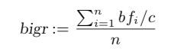
Error Detection - Feature Extraction
Process & Implementation
Create two lists of words: one contains ground truth as dictionary, the other contains tesseract outputs
Tokenized to word bases
Extract 14 features for every word in tesseract outputs
Most basic: length; number of vowels, consonants, special symbols, upper/lower case, digits
Consecutive same symbol; consecutive consonants; most frequent symbol; non-alphabetical symbols
Bigram: calculate “naturalness”:
Construct labels for every word in tesseract outputs by searching the word in the ground truth dictionary
Label = 1 indicates the corresponding word is not an error
Label = 0 indicates the corresponding word is an error
Notes:
In our paper for error detection, we outperformed a rule-based system. First of all, we created two lists of words and tokenized to word bases. We chose the “ground truth” files as our historical dictionary. Secondly, we extracted a couple of basic features, such as number of vowels, consonants, special symbols etc. Bigram is one important feature which was used to detect the naturalness of our words. After we extracted 14 features for every word in the tesseract outputs, we constructed labels for every word by searching the word in ground truth dictionary, Label= 1 indicates the corresponding word is not a garbage token, whereas label= 0 indicates the word is an error

Slide 6
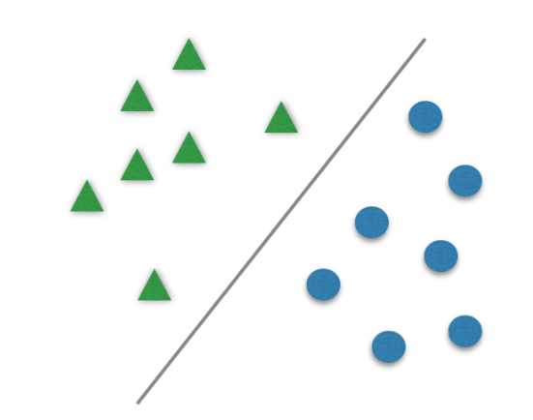
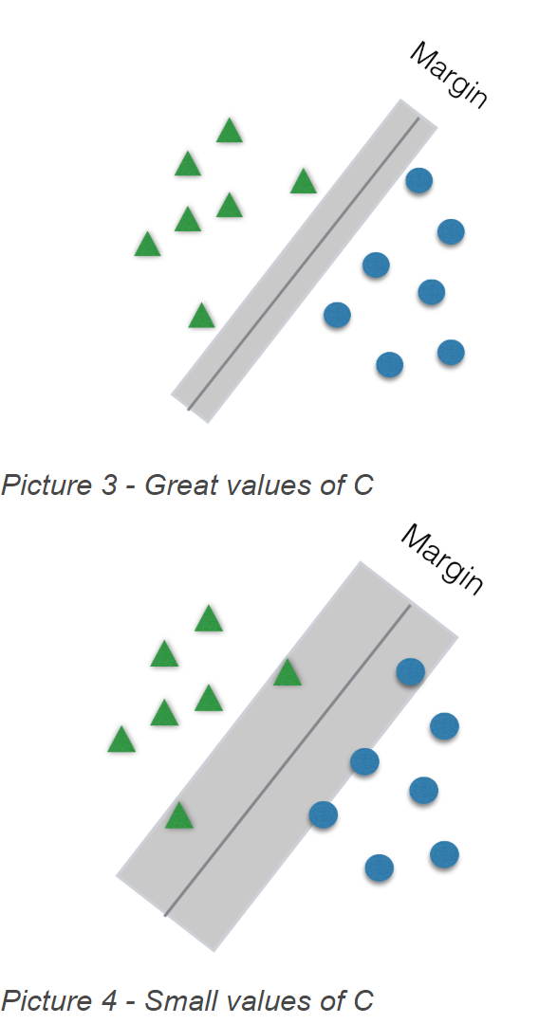
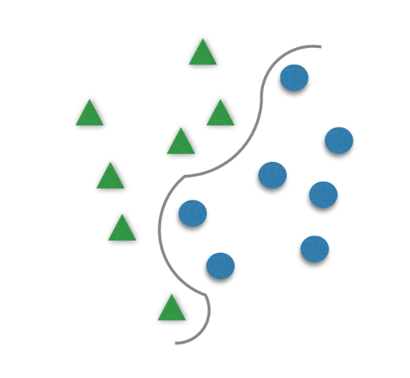
Error Detection- Support Vector Machine (SVM)
Process & Implementation
Classify Data in TWO Categories
Check SVM Algo Parameters (Tune)
SVM sensitive to the parameters
10-fold cross validation: tune.svm
Gamma vs. Cost
Notes:
To classify data in two categories, we use SVM which usually divides data in two different sets by finding a "line" that better separates the points just like the graphs shown on the page. SVM is very sensitive to the choice of parameters and therefore we have to tune our model like using tune.svm() method. The two parameters we want to tune are gamma and cost. Basically gamma decides the hyperplane (line) and cost decides the margin.

Slide 7
Error Detection- Support Vector Machine (SVM)
Process & Implementation
Point Test Result (cost = 1, gamma = 1)
In Our Model: (Near 300k Tokens)
Trainset: 80% all Tokens
Testset A: 20% all Tokens [Accuracy 82%]
Testset B: 100% all Tokens [Accuracy 80%]
Notes:
Our final SVM model has cost equals one and gamma equals one. Here is the outcome of our model. We divided all the tokens into train set 80 % and test set 20% for A, 100% for B. In the paper D3, the authors only used test set A to evaluate their method with grid search tuning with 88% accuracy. So we consider our model is good enough with 82% accuracy. Test set B was not discussed in the paper, however, for the purpose of correction part, we need a predicted dictionary and therefore we constructed the test set B. Test set B has slightly lower accuracy (80%) than Test set A which is again “good enough”.

Slide 8
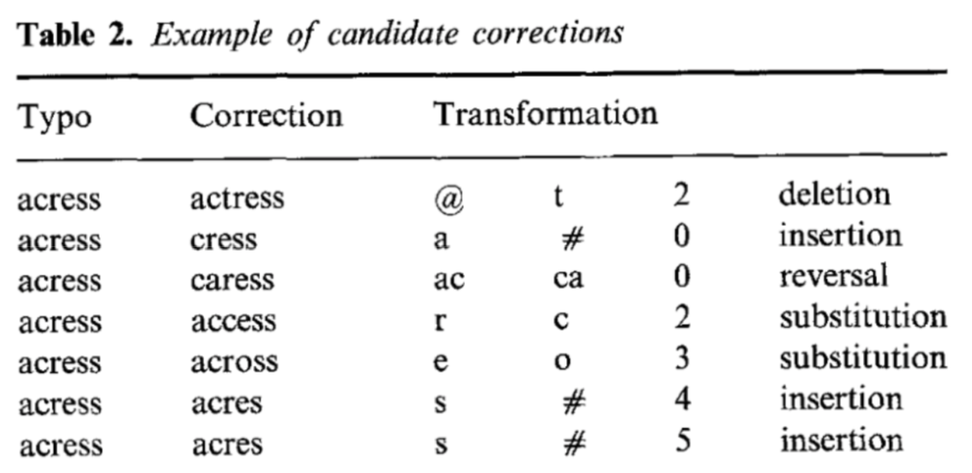
Error Correction - Propose candidate corrections
Process & Implementation
The candidate list is generated by applying any single transformation of following categories:
Insertion
Deletion
Substitution
Reversal
Notes:
Given the detected word error, in order to find the best correction, we need to generate the candidate corrections
The candidate list is generated by applying any single transformation of following categories: Insertion, Deletion, Substitution and Reversal. This means we need to insert, delete or substitute a single character in the word error or switch the position of two neighbor characters.

Slide 9
Error Correction - Probability Scoring
Process & Implementation
Each candidate correction is scored by the Bayesian combination rule Pr(c)Pr(t|c)
For P(c), ELE is used: (freq(c)+0.5)/(N+V/2)
For channel probability P(t|c), four confusion matrices are used:
Deletion:del[a,b]/chars[a,b]
insertion:add[a,t]/chars[a]
substitution:sub[t,a]/chars[a]
reversal:rev[a,b]/chars[a,b]
Notes:
After we got the candidate list, we scored each candidate correction by applying the Bayesian combination rule P(c)*P(t | c), where P(c) is the normalized frequency of the proposed correction c appears in the corpus and the P(t |c) is the channel probability computed from four confusion matrices.

Slide 10
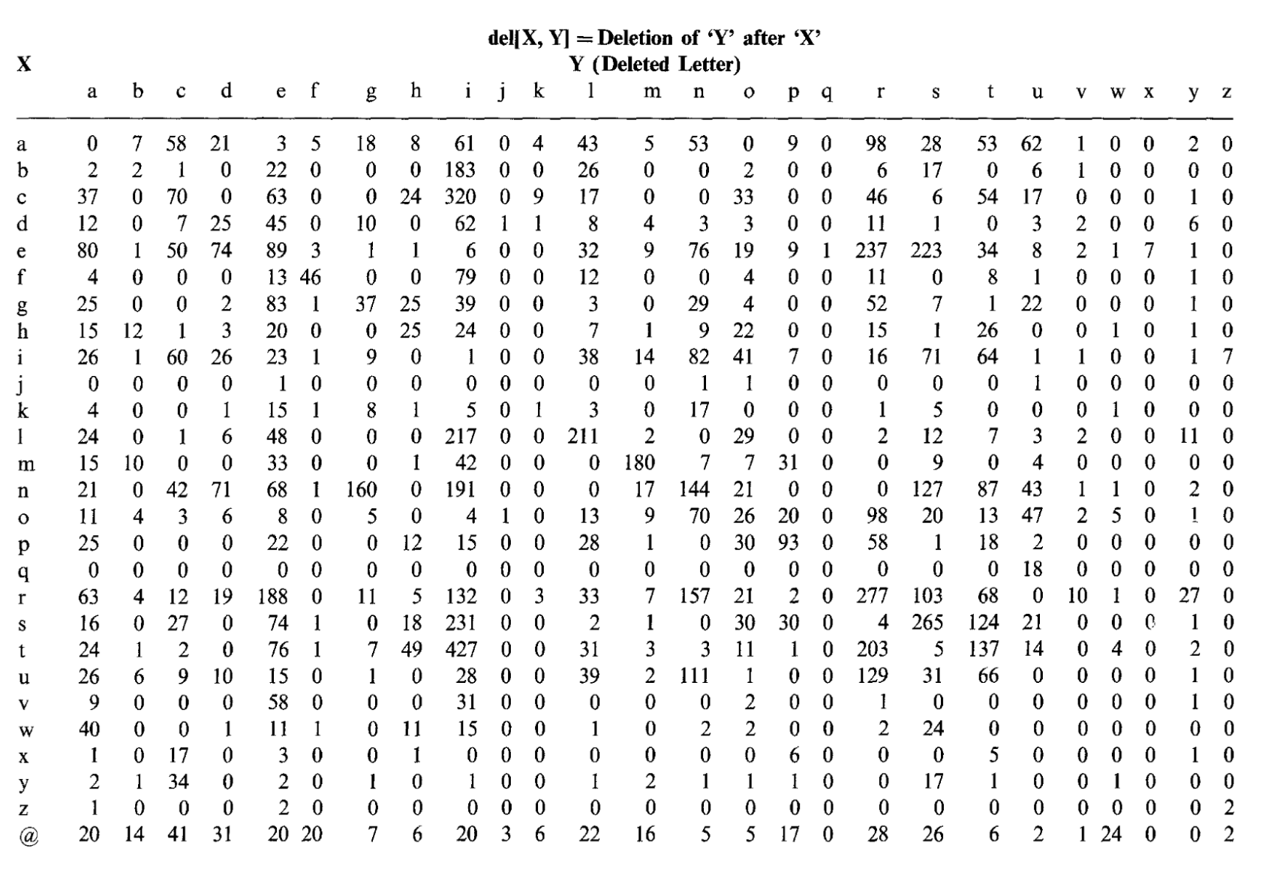
Error Correction- Confusion matrices -version A
Process & Implementation
Source: Associated Press (AP) 1988 - R package ‘topicmodels’
This version evaluates how much the matrix helps
Notes:
For confusion matrix, the paper assigned to us has already provided four standard confusion matrix constructed from Associated Press 1988. And we found the corresponding corpus from the R package ‘topicmodels’ so that we are able calculate the word frequencies from it. But by adopting this version, we are only evaluating how much the matrix helps, we also want evaluate the overall idea, rather than just the original method based on the original matrix.

Slide 11
Error Correction- Confusion matrices -version B
Process & Implementation
Source: Ground truth data as corpus
This version evaluates the overall idea, rather than just the original method based on the original matrix
Construct the confusion matrices:
Text alignment - limit the damage of a drift due to spacing
Only keep matched lines with same number of tokens for corpus construction
around 80% of all data
Create confusion matrices: del[X,Y], add[X,Y], sub[X,Y], rev[X,Y]
Notes:
We also want evaluate the overall idea, rather than just the original method based on the original matrix, so we adopted ground truth data as our corpus to construct our own confusion matrices. In order to accomplish text alignment, we only kept those matched lines with same number of tokens for corpus construction, which is about 80% of all data, this ensures that we still get enough amount of corpus to create a reliable confusion matrices.

Slide 12
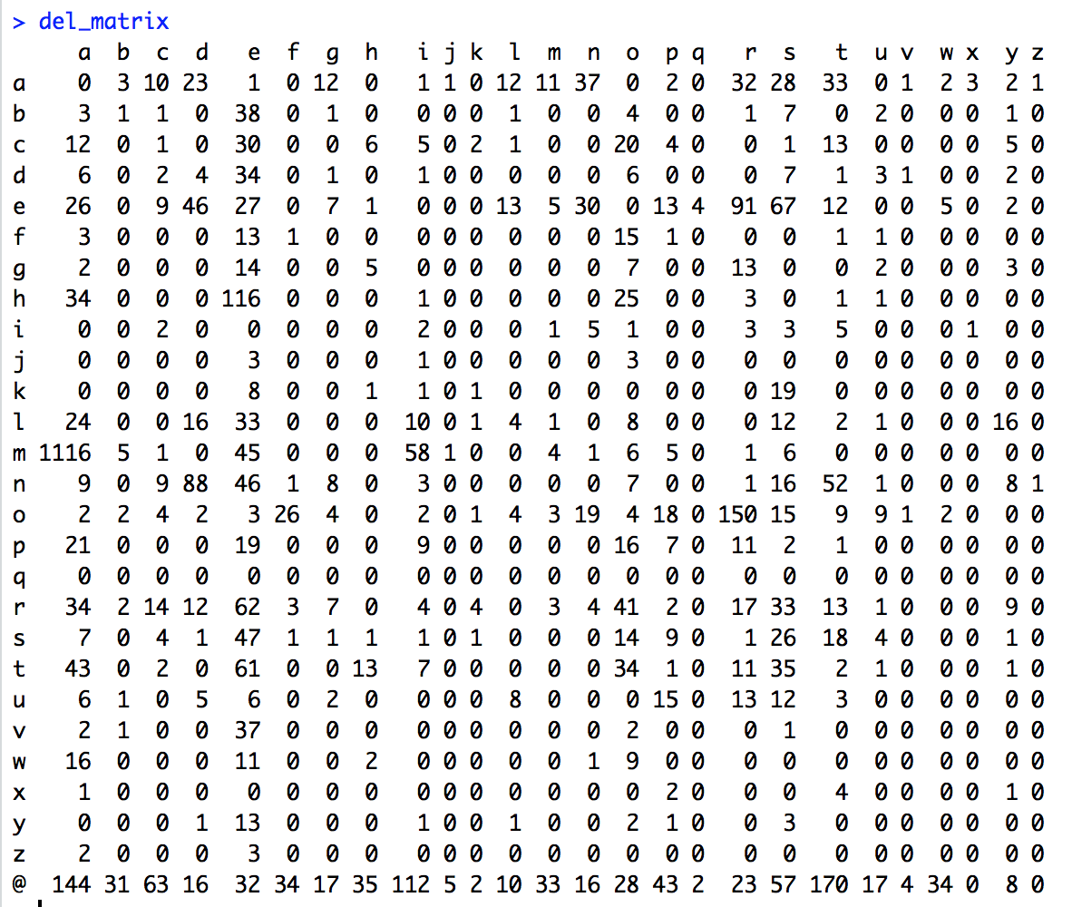
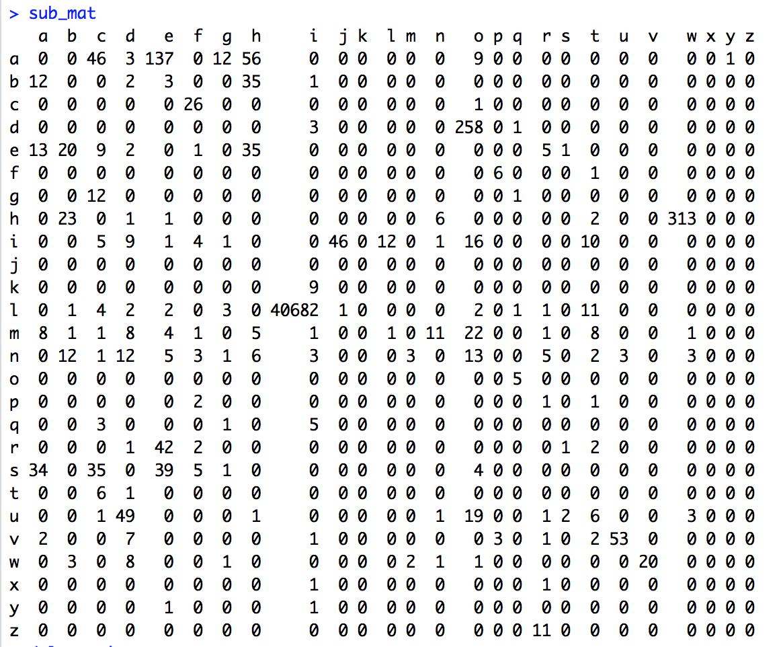
Error Correction- Confusion matrices -version B output
Process & Implementation
Notes:
Here are the two examples of our own confusion matrices. If we take a look on substitution matrix, the frequency number of the character l substituted by the character i is extremely high, which totally make sense, because they look very similar to each other.

Slide 13
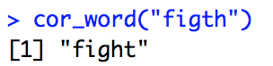
Error Correction - Output
Process & Implementation
Choose best candidate with the highest score by computing Pr(c)Pr(t|c)
Correct the word error predicted by SVM model
Notes:
With P(c) and P(t|c) available, now we are able to choose the best candidate by computing the multiply them together. And then correct the word error predicted by SVM model

Slide 14
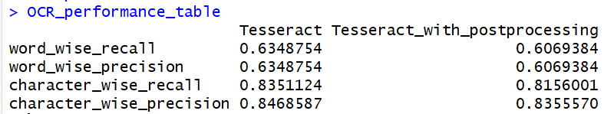
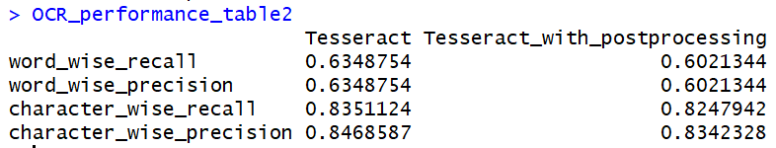
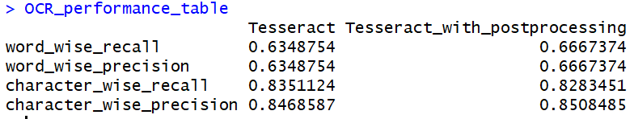
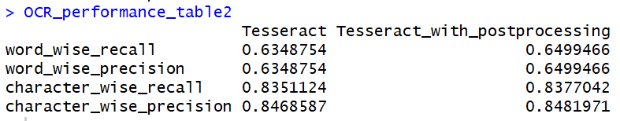
Word-level & Character-level Performance
Evaluation & Performance
Detection + Correction
Correction (Assuming Detected all correctly) - Just for Comparing
Source 1: Associated Press data
Source 2: Ground truth data
Source 1: Associated Press data
Source 2: Ground truth data
Notes:
We evaluated the performance of algorithms on word and character levels. First, with the detected garbage labels from the SVM model, the correctness of words and characters are both lower than the original OCR output among two sources (AP&Goundtruth). Second, assumed if we correctly detected all errors, the word_wise precisions are improved and higher than the originals, which means the correction algorithms may have some positive effects on post processing ORC output, but it depends on the quality of detection algorithm as well.

Slide 15
Limitation
The methodology of text processing.
Features of detection.
Due to Corpus size and one-step correction without context, error may still remain in the “corrected” word.
Notes:
Due to the natures of OCR output, some tokens would be recognized as two words, or two tokens as one word. It makes the text alignment more difficult, so we only got the lines with same number of tokens on ground truth and tesseract files. And we also found that some features would be not very useful for detection, such as feature 8. And the limitation of correction algorithm is that it depends on the corpus size and this method didn’t consider the context of tokens. And it only gives the candidates with highest probability to change one character, when there is more than two wrong characters in one token, this method may not suit for this case.

Slide 16
THANK YOU
ANY QUESTIONS?

